Slide 1
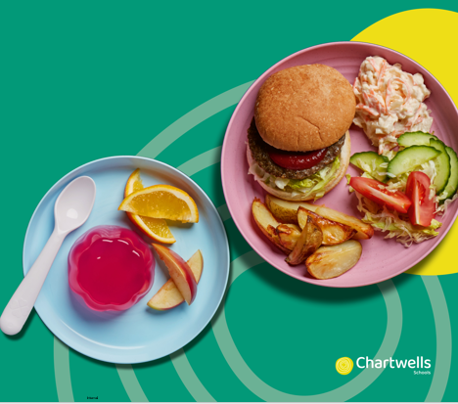
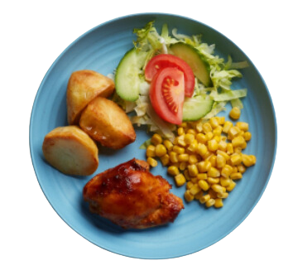



SIMPLICITY 3 WEEK MENU
2024 - 2025

Slide 2


ccc
WEEK 1
W/C: 04/11, 25/11, 16/12, 6/01, 27/01, 17/02 Half Term, 10/03, 31/03
Main Dish | Cheese & Tomato Pizza served with Diced Potatoes | BBQ Chicken served with Rice | Roast Chicken served with Roast Potatoes & Gravy | Beef Burger in a Bun served with Herby Diced Potatoes & Ketchup | Fish Fingers served with Mashed Potatoes
Vegetarian Dish | Veggie Cowboy Pasta | Macaroni Cheese | Quorn Sausages served with Roast Potatoes & Gravy | Veggie Burger in a Bun served with Herby Diced Potatoes & Ketchup | Veggie Dippers served with Mashed Potatoes
Jacket potato topping | Baked Beans | Grated Cheese | Tuna Mayonnaise | Baked Beans | Grated Cheese
Veg | Peas & Sweetcorn | Peas & Carrots | Vegetable Medley | Peas | Baked Beans
Dessert | Yoghurt & Fresh Fruit | Banana Marble Cake | Jammy Jack Flapjack | Vanilla Sponge served with Custard | Toffee & Apple Muffin
AUTUMN/WINTER 2024
Available Every Day – Water, fresh bread, yoghurt & fresh fruit

Slide 3
ccc
WEEK 2
W/C: 11/11, 02/12, 23/12 Christmas, 13/01, 03/02, 24/02, 17/03
Main Dish | Cheese & Tomato Pizza served with Diced Potatoes | Pork Sausages served with Mashed Potatoes | Roast Chicken served with Roast Potatoes & Gravy | Chicken Tikka Masala served with Rice | Battered Fish Fillet served with Chips
Vegetarian Dish | Veggie Balls in Tomato Sauce served with Rice | Cheese & Tomato Pasta | Quorn Sausages served with Roast Potatoes & Gravy | Macaroni Cheese | Veggie Dippers served with Chips
Jacket potato topping | Baked Beans | Grated Cheese | Tuna & Salmon Mayonnaise | Baked Beans | Grated Cheese
Veg | Peas & Sweetcorn | Peas & Carrots | Vegetable Medley | Peas | Baked Beans
Dessert | Yoghurt & Fresh Fruit | Oatie Cookie | Chocolate & Blackcurrant Sponge | Crispy Crackle Bar | Raspberry Slice
AUTUMN/WINTER 2024
Available Every Day – Water, fresh bread, yoghurt & fresh fruit

Slide 4
ccc
WEEK 3
W/C: 18/11, 9/12, 30/12 Christmas, 20/01, 10/02, 03/03, 24/03
Main Dish | Crispy Chicken Goujons in a Bun with Lettuce & Mayo served with Diced Potatoes | Macaroni Cheese | Roast Beef served with Roast Potatoes & Gravy | Beef Pasta Bolognese | Chicken Fillet served with Herby Diced Potatoes
Vegetarian Dish | Veggie Pasta Bolognese | Cheese & Vegetable Bake | Quorn Sausages served with Roast Potatoes & Gravy | Chickpea & Vegetable Masala served with Rice | Cheese & Onion Pasty served with Herby Diced Potatoes
Jacket potato topping | Grated Cheese | Baked Beans | Tuna Mayonnaise | Baked Beans | Grated Cheese
Veg | Peas & Sweetcorn | Peas & Carrots | Vegetable Medley | Peas | Baked Beans
Dessert | Yoghurt & Fresh Fruit | Apple Sponge Cake served with Custard | Crispy Crackle Bar | Original Flapjack | Mixed Berry Muffin
AUTUMN/WINTER 2024
Available Every Day – Water, fresh bread, yoghurt & fresh fruit

