Slide 1


Slide 2
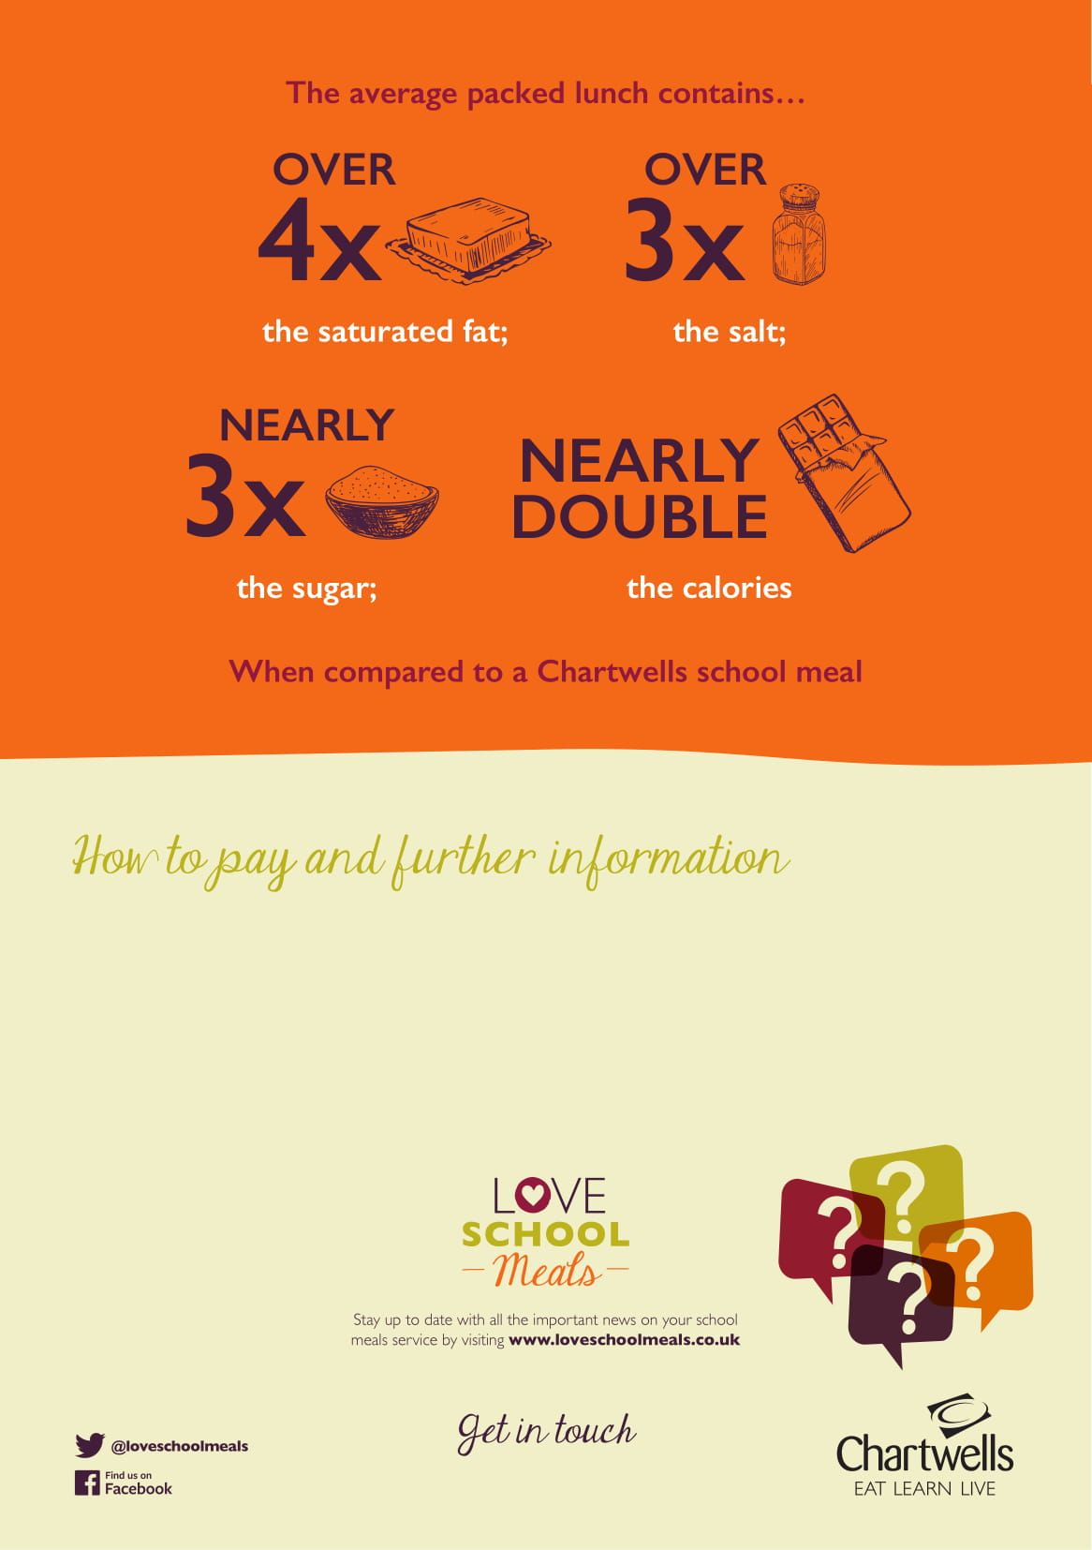
School meals currently cost £2.60 per day in your school. Pupils can choose to eat every day or pick their favourite days to eat with us.
You can pay for your school meals by visiting:
Dorset Meal Selector | Home If you do not have an account please go online and Register.
Compass Group UK & Ireland
Guildford Street
Chertsey
KT16 9BQ

