Slide 1
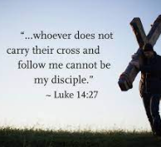
Our Gospel Value this
week is
Courage
https://www.youtube.com/watch?v=YXg2ztge8f0
Our Virtue this week is
Faith

Slide 2
We gather together to love, value and respect each other within our Catholic family, to nurture each individual’s talents and skills as Jesus taught us.
Everyone matters and is loved by God.
Peace be with you
and with your Spirit

Slide 3
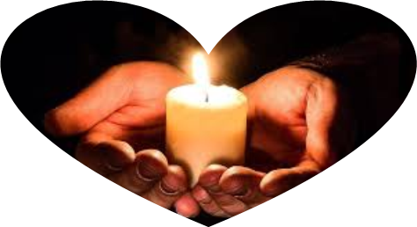
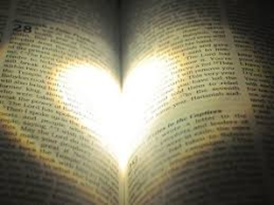
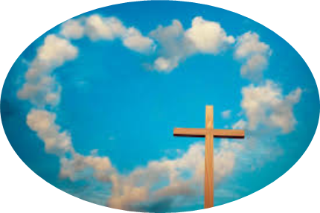
Jesus Christ light of the world
  … shine brightly in our lives
Jesus Christ God’s living Word
  … speak to us your truth
Jesus Christ God’s love revealed
  ... dwell among us

Slide 4
Our lit candle reminds us that we are in God’s presence as we mark ourselves with the sign of the cross
In the name of the Father,
and of the Son
and of the Holy Spirit
Amen

Slide 5
We Say Sorry
You call us to follow you
Lord, have mercy.
Lord, have mercy.
You call us to trust in you
Christ, have mercy.
Christ, have mercy.
You open your arms to all of us
Lord, have mercy.
Lord, have mercy.

Slide 6
Today Jesus tells the crowds that if they want to follow him and be his disciples then they need to give up everything.
Let's find out more…

Slide 7
Guiding Lord,
may we love you and follow you all the days of our lives.
Amen

Slide 8
Alleluia, Alleluia, Jesus is the Lord,
He’s the Lord of all my heart.
Alleluia, Alleluia, Jesus is the Lord,
He’s the Lord of all my heart.
He’s the way, he’s the truth,
he’s the life.
He’s the way, he’s the truth,
he’s the life.
Alleluia, Alleluia, Jesus is the Lord,
He’s the Lord of all my heart.

Slide 9
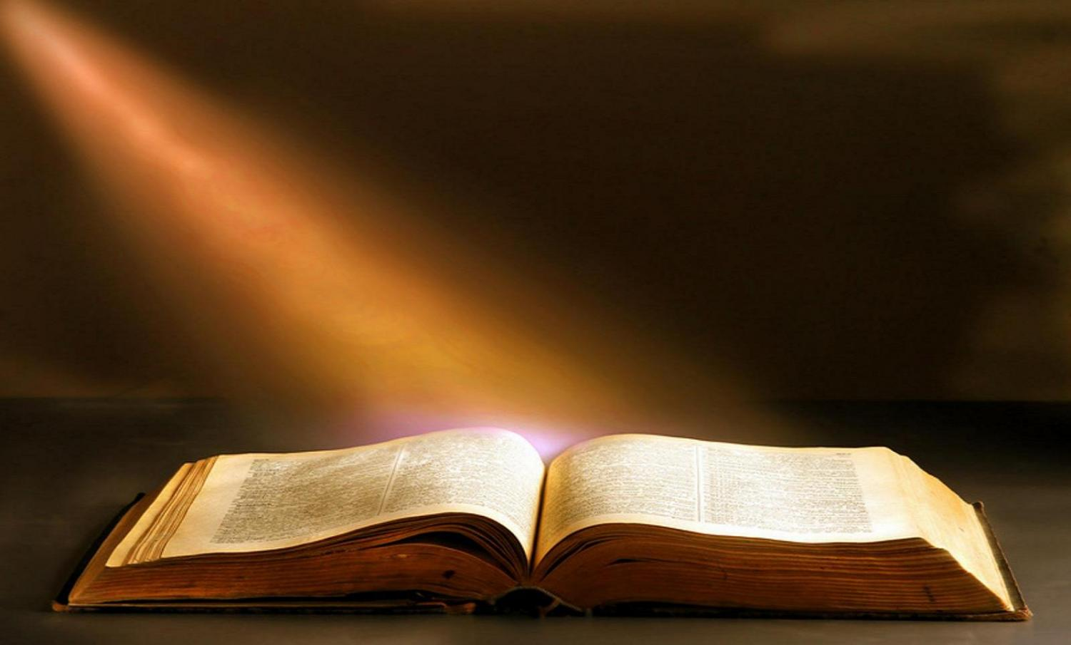
We listen to the word
Gospel according to Luke 14:25-33
May the words of Jesus be
On my mind
On my lips and
In my heart
The Gospel of the Lord
Praise to you Lord Jesus Christ
Notes:
Once when large crowds of people were going along with Jesus, he turned and said to them, “Those who come to me cannot be my disciples unless they love me more than they love father and mother, wife and children, brothers and sisters, and themselves as well. Those who do not carry their own cross and come after me cannot be my disciples.
“If one of you is planning to build a tower, you sit down first and work out what it will cost, to see if you have enough money to finish the job. If you don't, you will not be able to finish the tower after laying the foundation; and all who see what happened will laugh at you. ‘This man began to build but can't finish the job!’ they will say.
“If a king goes out with 10,000 men to fight another king who comes against him with 20,000 men, he will sit down first and decide if he is strong enough to face that other king. If he isn't, he will send messengers to meet the other king, to ask for terms of peace while he is still a long way off. In the same way,” concluded Jesus, “none of you can be my disciple unless you give up everything you have.”

Slide 10
Alleluia, Alleluia, Jesus is the Lord,
He’s the Lord of all my heart.

Slide 11

We are still and silent as we reflect on God’s word for us in the Gospel.

Slide 12
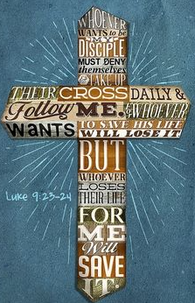
What do you remember from today's reading?

Slide 13
Jesus tells the crowds two short stories to explain what being a disciple means, and to show us that if we want to follow him we must give up everything.
What do you think “giving up everything” means?

Slide 14
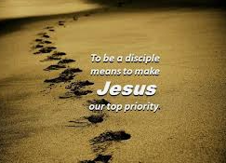
I think that it means that we need to try to see that Jesus is the most important person in our lives.
We must also “carry our cross” which means accepting the things we find difficult in our lives and asking for God's help in these difficult things.

Slide 15
These difficult things might be people we find it hard to get on with, lessons in school that we find boring or wanting something we can't have. It might be not having enough to eat or even living somewhere where there is violence.

Slide 16
For a few moments in silence, think about what you find difficult and ask for God's help now.
Then still in silence pray for each other - that God will be with all of us. While we do this, we know that we are all supported in prayer.

Slide 17
Let's look at the two stories now...
The first story is about a man who wants to build a tower. He must work out the cost to make sure he has enough money and resources to finish the job.
The second story is about a king who is going to war. He must first count his soldiers and resources to make sure he can win the battle.

Slide 18

What do you think these stories are telling us?

Slide 19
Both stories tell us about how important it is not to rush straight into something without thinking about it first. We need to prepare so that we can see our project through to the finish. It needs to be done properly.

Slide 20
Perhaps you can think of something big that you were asked to do. Maybe you thought it was too hard and that you’d never manage it, but it turned out you could do it! How did you feel when you had finished?

Slide 21
And is there anything that you’ve ever rushed into without thinking about it and then you weren’t able to finish or it went wrong?
Perhaps you were asked to help your friends at school or to help around the house and you didn’t do as much as you could?

Slide 22
How did you feel about that?
And how do you think the person who asked you to help in the first place felt?

Slide 23
Jesus is telling us that following him and being a disciple is something that we have to see through to the finish. We need to follow Jesus always and this isn't always easy. Often we are distracted by other people or by thinking about what we want, rather than about what Jesus wants for us.

Slide 24

Throughout our lives as followers of Jesus we might have to choose to do what Jesus wants even if it means not always being popular.
It is hard but God is with us all the way to help and guide us.

Slide 25
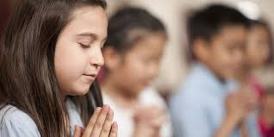
In silence, pray for each other - that God will be with all of us.

Slide 26
Jesus asked us to follow him and so we pray together:

Slide 27
We pray for the Church: that it may always work to share God’s love with all, and especially with those who are poor, sick or ignored.
Lord in Your mercy
Hear our prayer

Slide 28
We pray for leaders in our communities: that they may do their best to serve everyone they meet, even when it is difficult or makes them unpopular.
Lord in Your mercy
Hear our prayer

Slide 29
We pray for our school, parish, families and friends: that we may be disciples together and support each other in all that life gives us.
Lord, in your mercy
Hear our prayer

Slide 30
In this Jubilee Year, we pray that we may be signs of hope in our world through all that we do and how we treat one another.
Lord, in your mercy
Hear our prayer

Slide 31
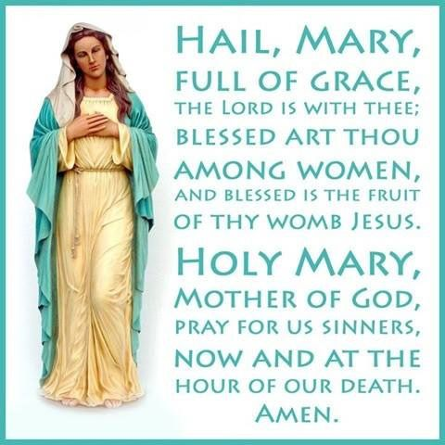
We take a moment now to pray for our own intentions.
We ask Our Lady to intercede on our behalf as we say together…

Slide 32
Guiding Lord, give us courage to know you, to love you, to follow you always in how we treat others and care for our world.
Amen.

Slide 33
St Anthony
Pray for us
St Mark
Pray for us
St Francis
Pray for us
St Alban
Pray for us

Slide 34
How will you follow Jesus this week?

Slide 35
In the week ahead let’s try to…
do one thing to show that you follow Jesus, and finish it, even if it is difficult.

Slide 36
Jesus, I offer my day to you
Jesus, I offer my day to you
Jesus, I offer my day to you

Slide 37
Let us go in peace
Thanks be to God

Slide 38
Our Gospel Value this
week is
Courage
https://www.youtube.com/watch?v=rMmSPOF-6Xo
Our Virtue this week is
Faith

